Slide 1
ROM (Read Only Memory)
It is a storage device in which a fixed set of binary information is stored.
Non-volatile .
ROM contains special internal links that can be fused or broken.
Block diagram of ROM
Product terms
Inputs lines
AND array
OR array
outputs lines

Slide 2
Types of ROM
Mask ROM
PROM
EPROM
UV PROM
EEPROM

Slide 3
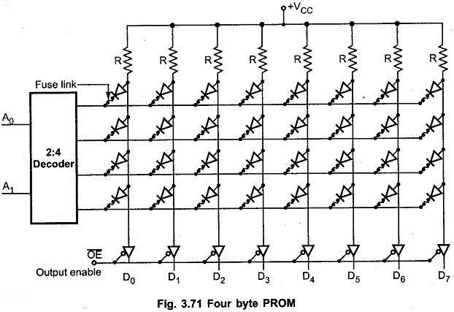

Slide 4
PLA(Programmable logic arrays)
A PLA consist of a programmable AND array and a Programmable OR array. The PLA is also called a field Programmable logic array(FPAL)because the user in the field program it, not the manufacture.
It is used alternative of ROM where don’t care condition is excessive.
Block diagram of PLA
Inputs
Programmable AND array
Programmable OR array
output

Slide 5
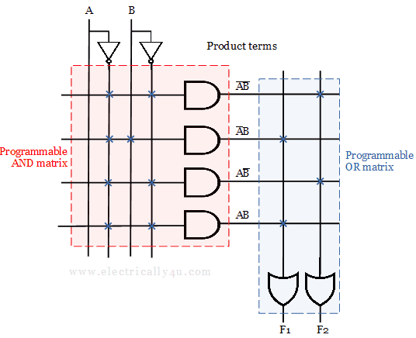

Slide 6
Implement Given function using PLA
F₀ =∑m (0,1,4,6) , F₁ =∑m (2,3,4,6,7), F₂ =∑m (0,1,2,6)
Assignment
Advantage, Disadvantage and Application of PAL.

Slide 7
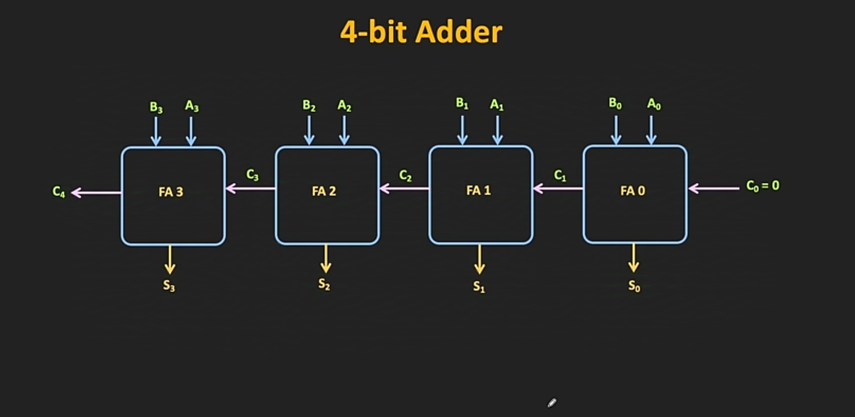

Slide 8
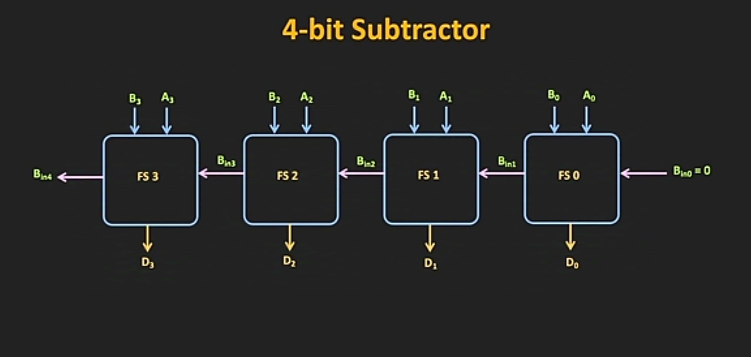

Slide 9
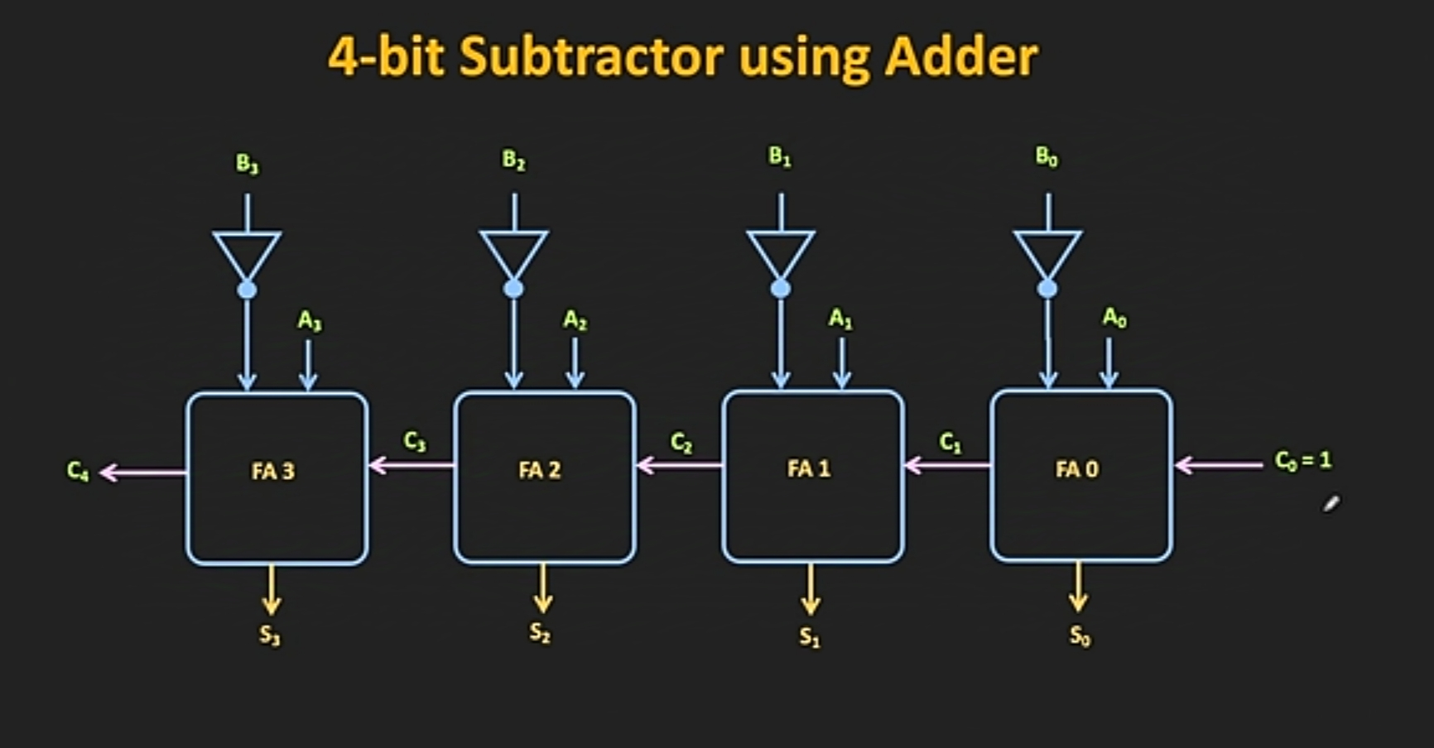

Slide 10
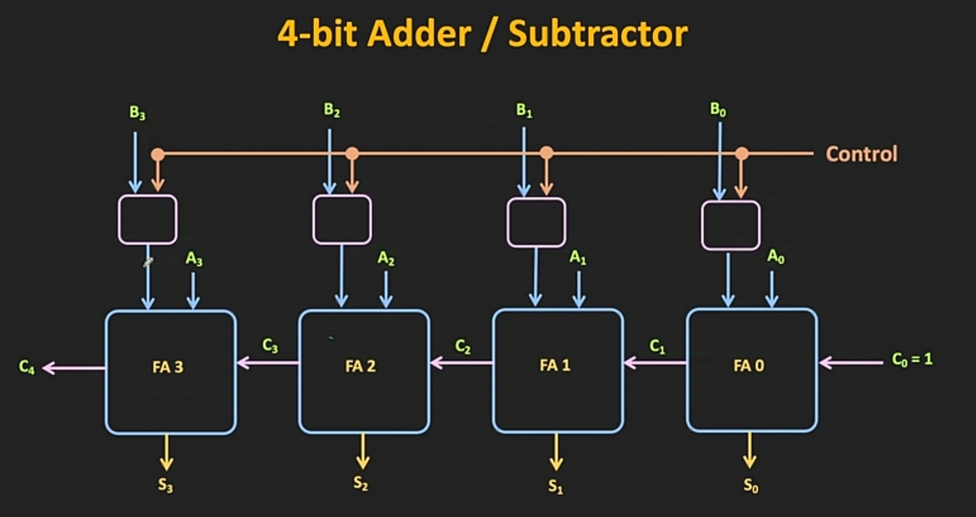

Slide 11
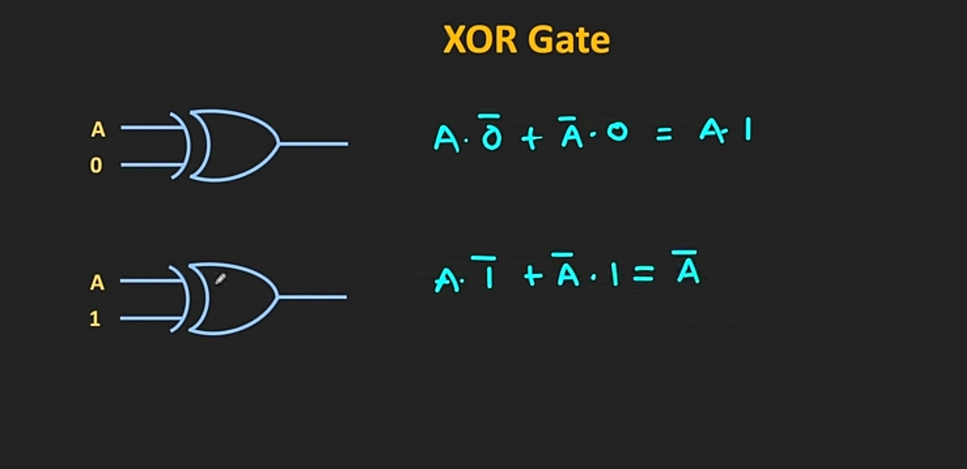

Slide 12
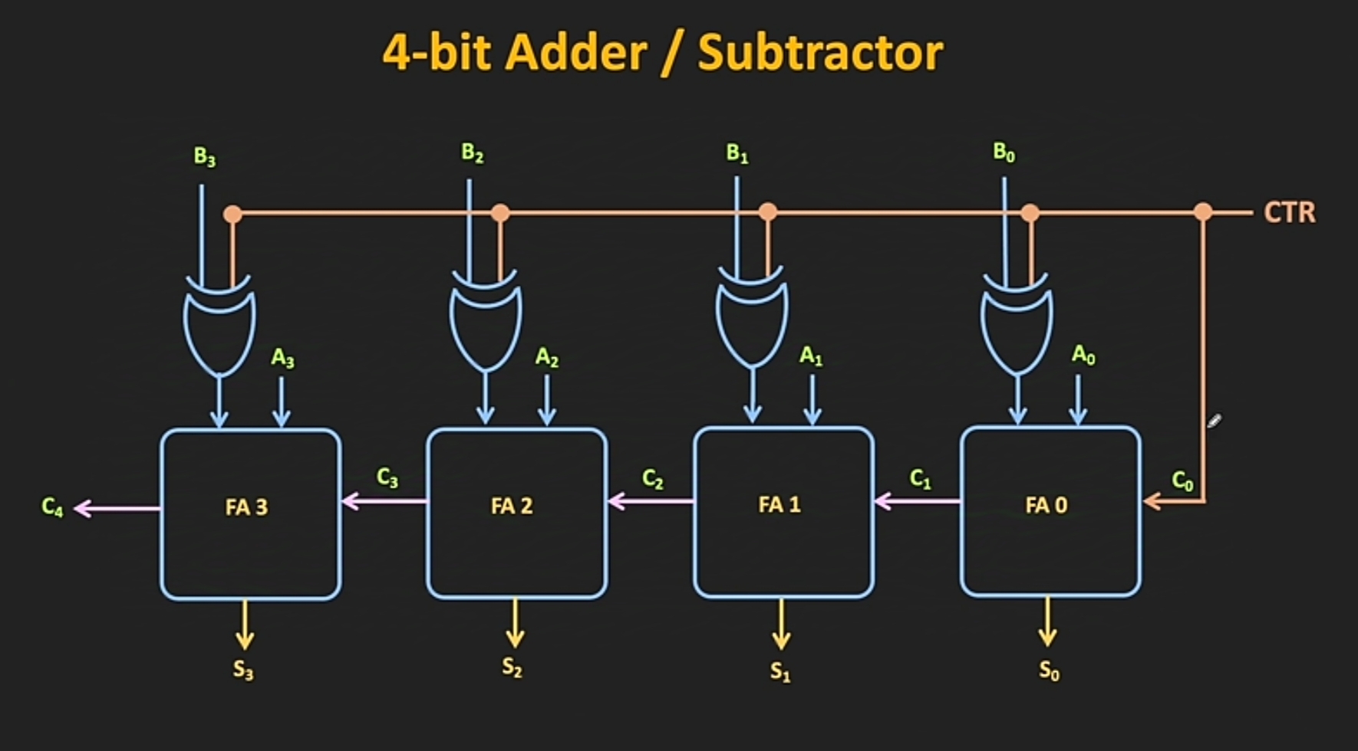

Slide 13
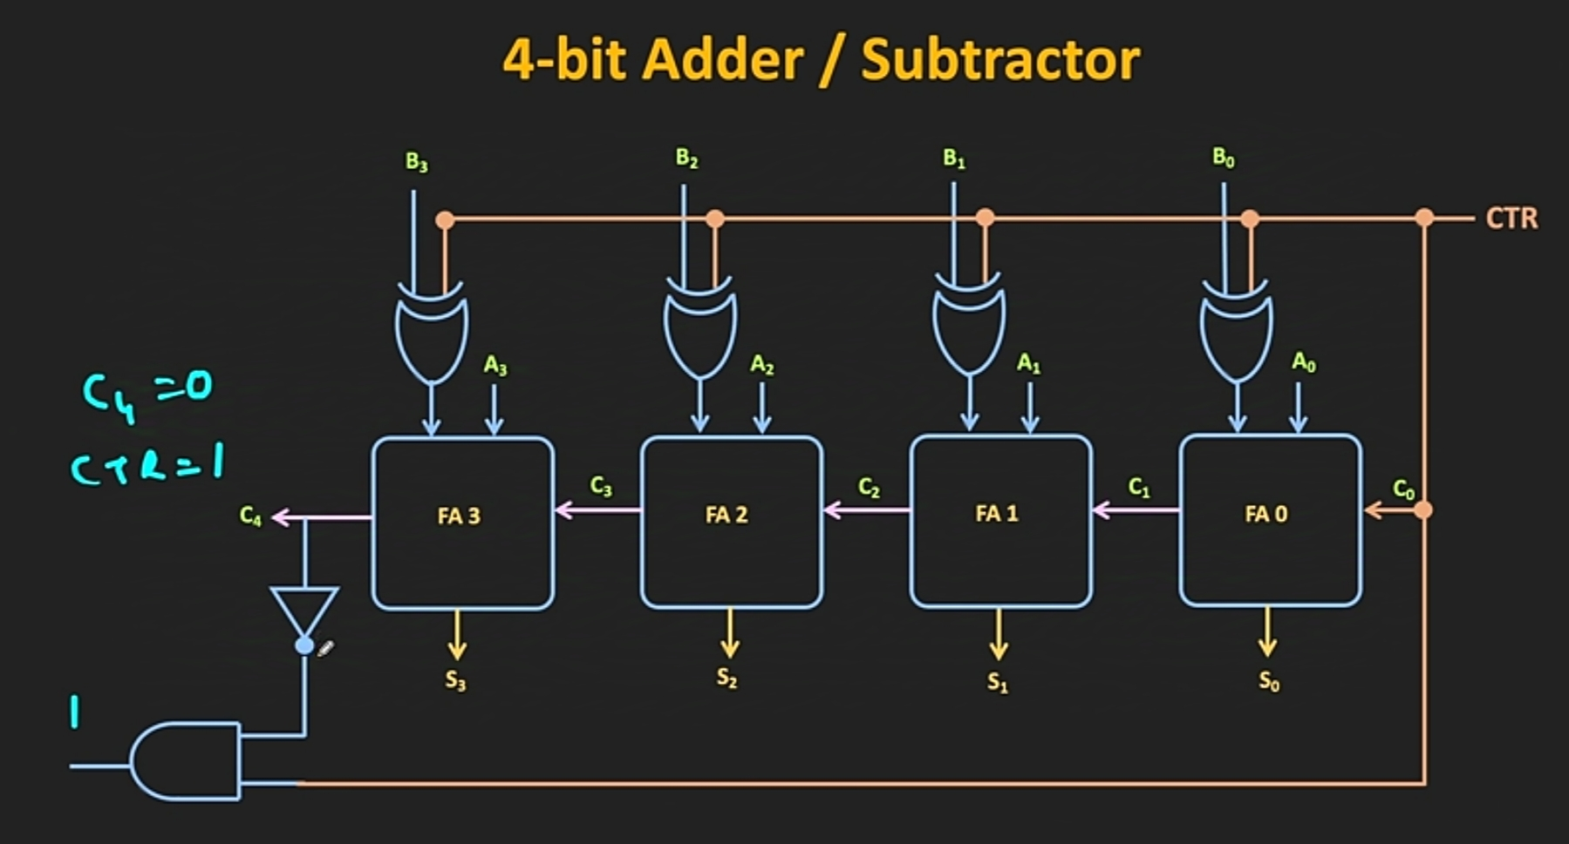

Slide 14
